Slide 1
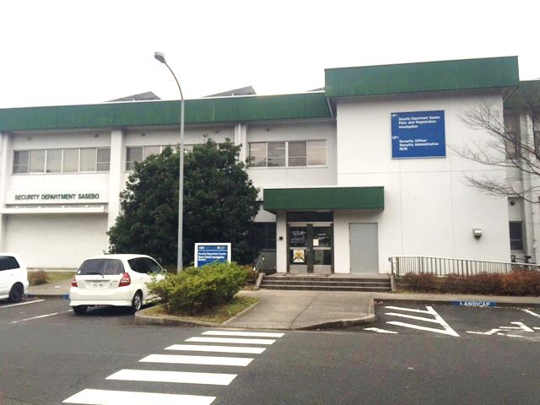
CFAS Security Department

Slide 2
BLDG 320 Location
Vehicle:
Walking:

Slide 3
Vehicle Requirements
USFJ Form 4EJ Driver’s permit - obtained at CFAS Safety Driver’s License Office prior to the initial registration at CFAS Security Vehicle Registration Office (VRO).
All vehicles must be registered in SOFA sponsor’s name.
One vehicle per driver license holder not to exceed two vehicles for each family, not include one motorcycle can be registered with VRO.
Two mandatory insurances: Japanese Compulsory Insurance (JCI) and Pre-purchased Automobile Liability Insurance for the next 12 months.
Safety vehicle inspection every two years is mandated by Gov’t of Japan.
Annual Road Tax payment to Gov’t of Japan . Payment is due in April-May. Price vary from 500yen to 32,000yen per vehicle type.

Slide 4
GOJ Registration
After initial registration at VRO, buyers will have 14 days to complete registration process with Government of Japan (GOJ).
In most cases, GOJ registration will be completed by dealers, auto shops, Land Transportation Office (LTO) runners. Detailed information will be provided by Security Vehicle Registration Office (VRO).
Upon completion of GOJ registration, USFJ Decal will be issued.
All vehicles must be sold or junked 10 days prior to PCS departure date!! Abandoning vehicles are prohibitted.

Slide 5
DE-Register Your Vehicle Before You Leave
All personnel are required to checkout with the CFAS VRO before transferring from Sasebo on PCS orders, transfer, separation. You will not be allowed to check out of your respective command without first receiving a stamped checkout sheet from the CFAS VRO.
The owner of the vehicle must provide proof that the vehicle has either been sold, re-registered by another person or that it has been properly disposed of.
Selling vehicles after sponsor ‘s transfer date is strictly controlled and requires approval.
Don’t wait until the last minute, VRO will assist you with any questions you have during the process.

Slide 6
CFAS Security VRO Hours
Open:
Monday, Tuesday, Wednesday and Friday
(0730-1215/1315-1500)
Thursday (0730-1215/1315-1400)
Closed:
Weekends, US Holidays and Japanese New Year Holidays

Slide 7
VRO Contact Information
Facebook: https://www.facebook.com/CFASVRO
DSN: 252-2378/2377/2373
Commercial Phone:
0956-50-2378/2377/2373
E-Mail Address:
M-SA-CFAS-VRO-GD@FE.NAVY.MIL

Slide 8
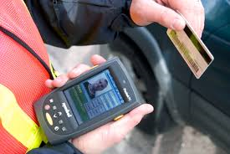
DBIDS Registration
DBIDS is utilized to scan ID cards for base access.
Anyone with a CAC or a dependent ID must register with DBIDS.
Registration office is located at the CFAS Security Department.
Upon receiving a new ID card, you must re-register.
Hours of operation:
Mon/Tue/Wed/Fri: 0730-1215/1315-1500
Thu: 0730-1215/ 1315-1400
DBIDS registration phone: 0956-50-2375 or from DSN: 252-2375.

Slide 9
Lost and Found
Lost and Found items shall be reported to Security Front Office.
Customer service window is available 24 hours a day, 7 days a week including holidays.
You may call 0956-50-3725 or 0956-50-3446.

Slide 10
Fingerprinting
Please visit CFAS Security.
Customer service window is available 24 hours a day, 7 days a week including holidays.
You may call 0956-50-3725 or 0956-50-3446.

Slide 11
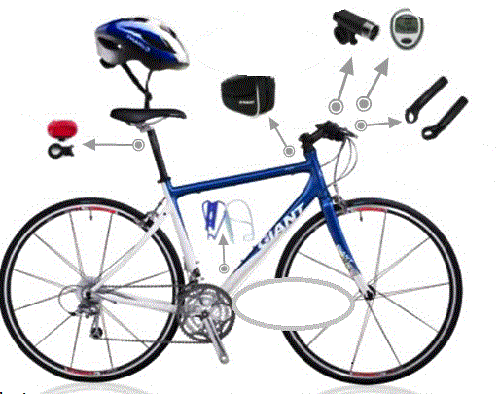
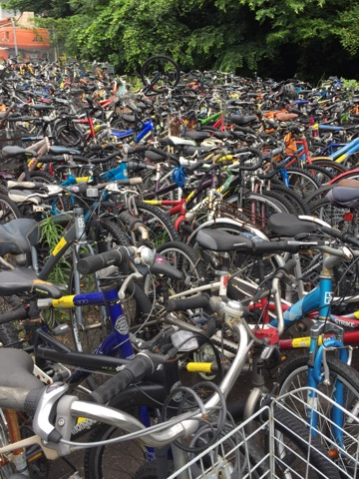
Bicycles
Registration is mandatory. Register at Security. Required PPE to register:
Bicycle with horn or bell
Helmet
Front and rear reflector
Hand breaks
Light for nighttime riding
Bicycles found in violation are subject to impoundment.
Please call Security at DSN 252-2372 if you feel your bicycle has been impounded or stolen.
You must go to Security with proof of ownership and the CFAS bicycle registration number provided to you when you registered it.
Bicycles that have not been claimed for over
120 days may be subject for disposal.

Slide 12
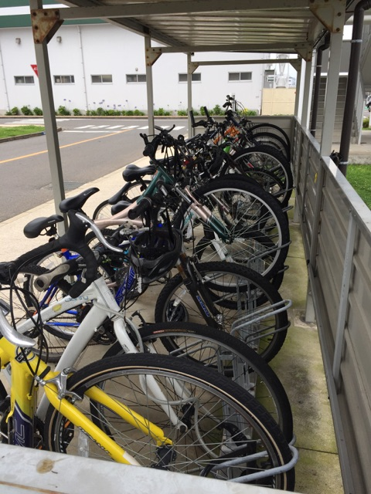
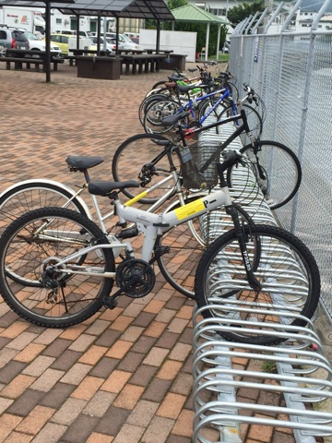
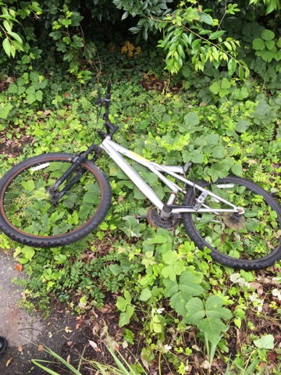
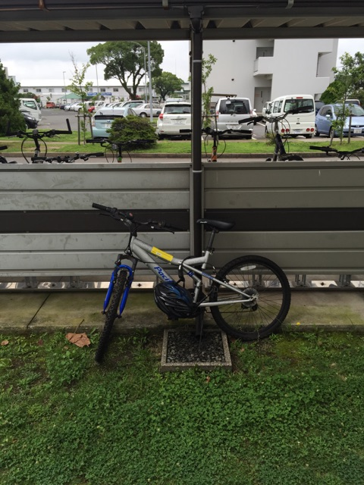
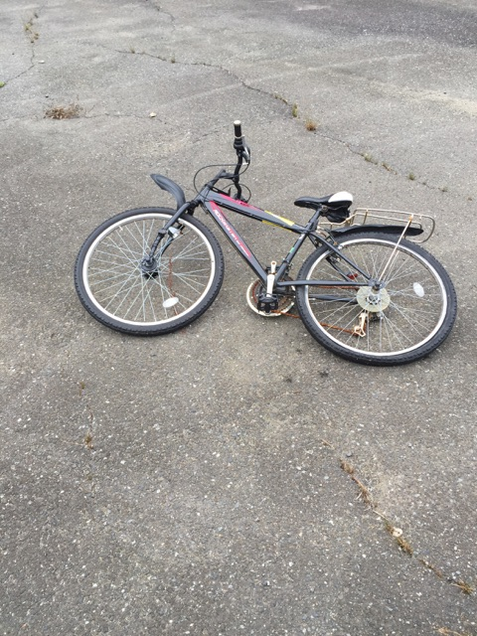
Only park it in designated areas
Don’t park your bicycle under stairways, against any fence or against buildings

Slide 13
Important Phone Numbers
AMBULANCE / FIRE / MEDICAL
911 (On Base) / 0956-50-0911 (Off Base or Cell Phone)
119 (Cell Phone or Off Base Japanese Services)
CFAS Security
252-3446 (On Base) / 0956-50-3446 (Off Base)
All information can be found at the link below:
http://www.cnic.navy.mil/regions/cnrj/installations/cfa_sasebo/om/Security/html

